Slide 1
Chapter 8
Cost Estimation and Budgeting

Slide 2
Chapter 8 Learning Objectives
After completing this chapter, students will be able to:
Understand the various types of common project costs.
Recognize the difference between various forms of project costs.
Apply common forms of cost estimation for project work, including ballpark estimates and definitive estimates.
Understand the advantages of parametric cost estimation and the application of learning curve models in cost estimation.

Slide 3
Chapter 8 Learning Objectives
After completing this chapter, students will be able to:
Discern the various reasons why project cost estimation is often done poorly.
Apply both top-down and bottom-up budgeting procedures for cost management.
Understand the uses of activity-based budgeting and time-phased budgets for cost estimation and control.
Recognize the appropriateness of applying contingency funds for cost estimation.

Slide 4
Cost Management
Cost management has been defined to encompass data collection, cost accounting, and cost control.
Cost accounting and cost control serve as the chief mechanisms for identifying and maintaining control over project costs.
Cost estimation processes create a reasonable budget baseline for the project.

Slide 5
Common Sources of Project Cost
Labor
Materials
Subcontractors
Equipment & facilities
Travel

Slide 6
Types of Costs
Direct Vs. Indirect
Recurring Vs. Nonrecurring
Fixed Vs. Variable
Normal Vs. Expedited

Slide 7
Cost Classifications
Non-recurring
Recurring
Variable
Expedited
Indirect
Normal
Direct
Fixed
Costs
Direct Labor | X |  | X |  | X |  | X
Building Lease |  | X | X |  | X |  | X
Expedite | X |  |  | X |  | X |  | X
Material | X |  | X |  |  | X | X
Copyright © 2013 Pearson Education, Inc. Publishing as Prentice Hall

Slide 8
Cost Estimation
Ballpark (order of magnitude) ±30%
Comparative ±15%
Feasibility ±10%
Definitive ±5%

Slide 9
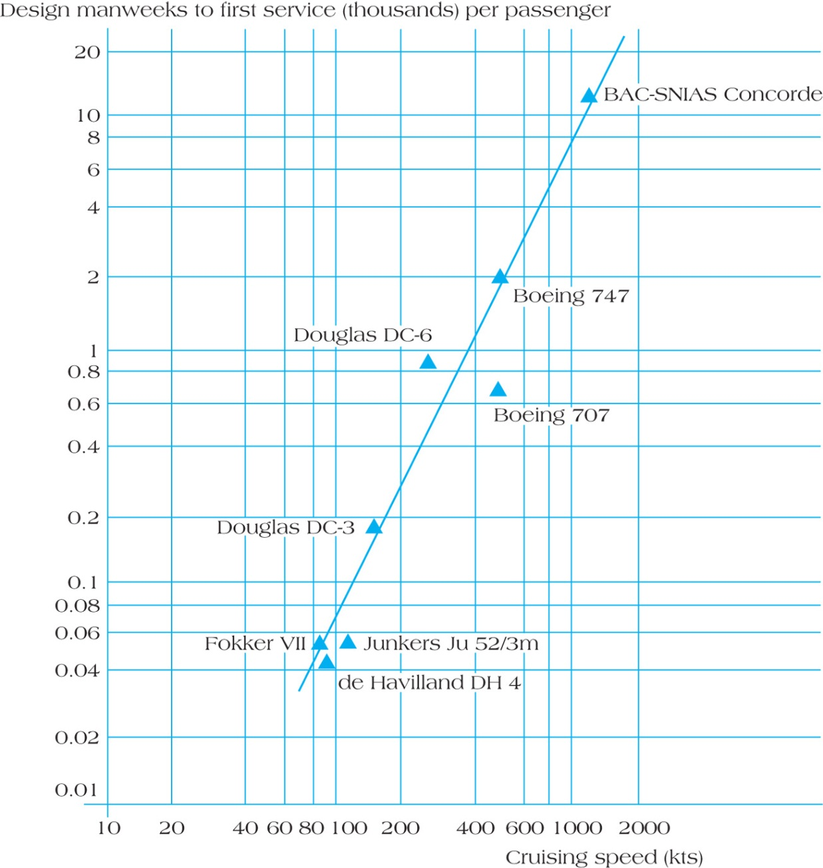
Parametric Estimate for Design Costs for Concorde
FIGURE 8.2
Copyright © 2013 Pearson Education, Inc. Publishing as Prentice Hall

Slide 10
Learning Curves
Each doubling of output results in a reduction in time to perform the last iteration.

Slide 11
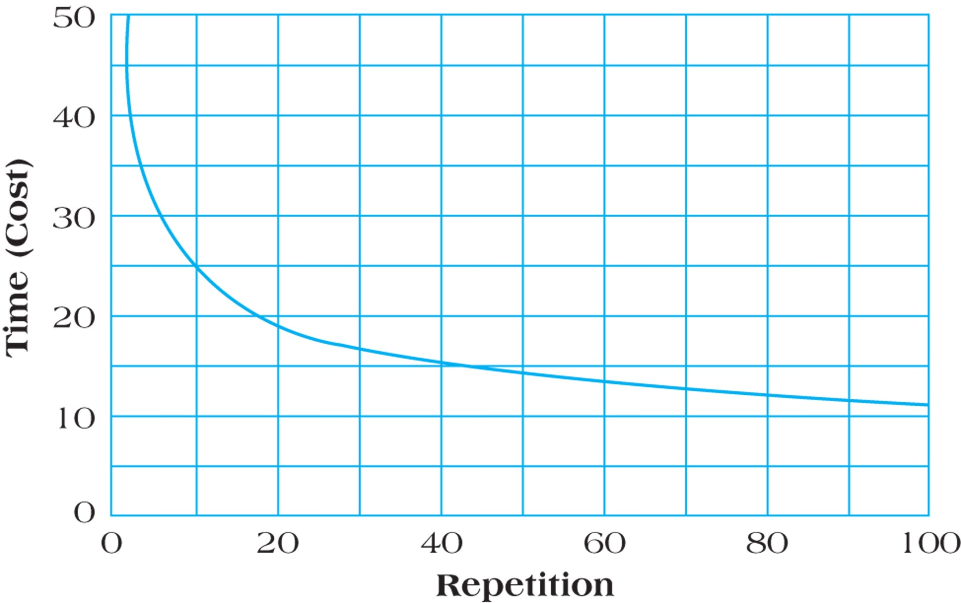
Unit Learning Curve Log-Linear Model
FIGURE 8.4
Copyright © 2013 Pearson Education, Inc. Publishing as Prentice Hall

Slide 12
Software Project Estimation – Function Points
Function Point Analysis is a system for estimating the size of software projects based on what the software does.
Function points are a standard unit of measure that represents the functional size of a software application.

Slide 13
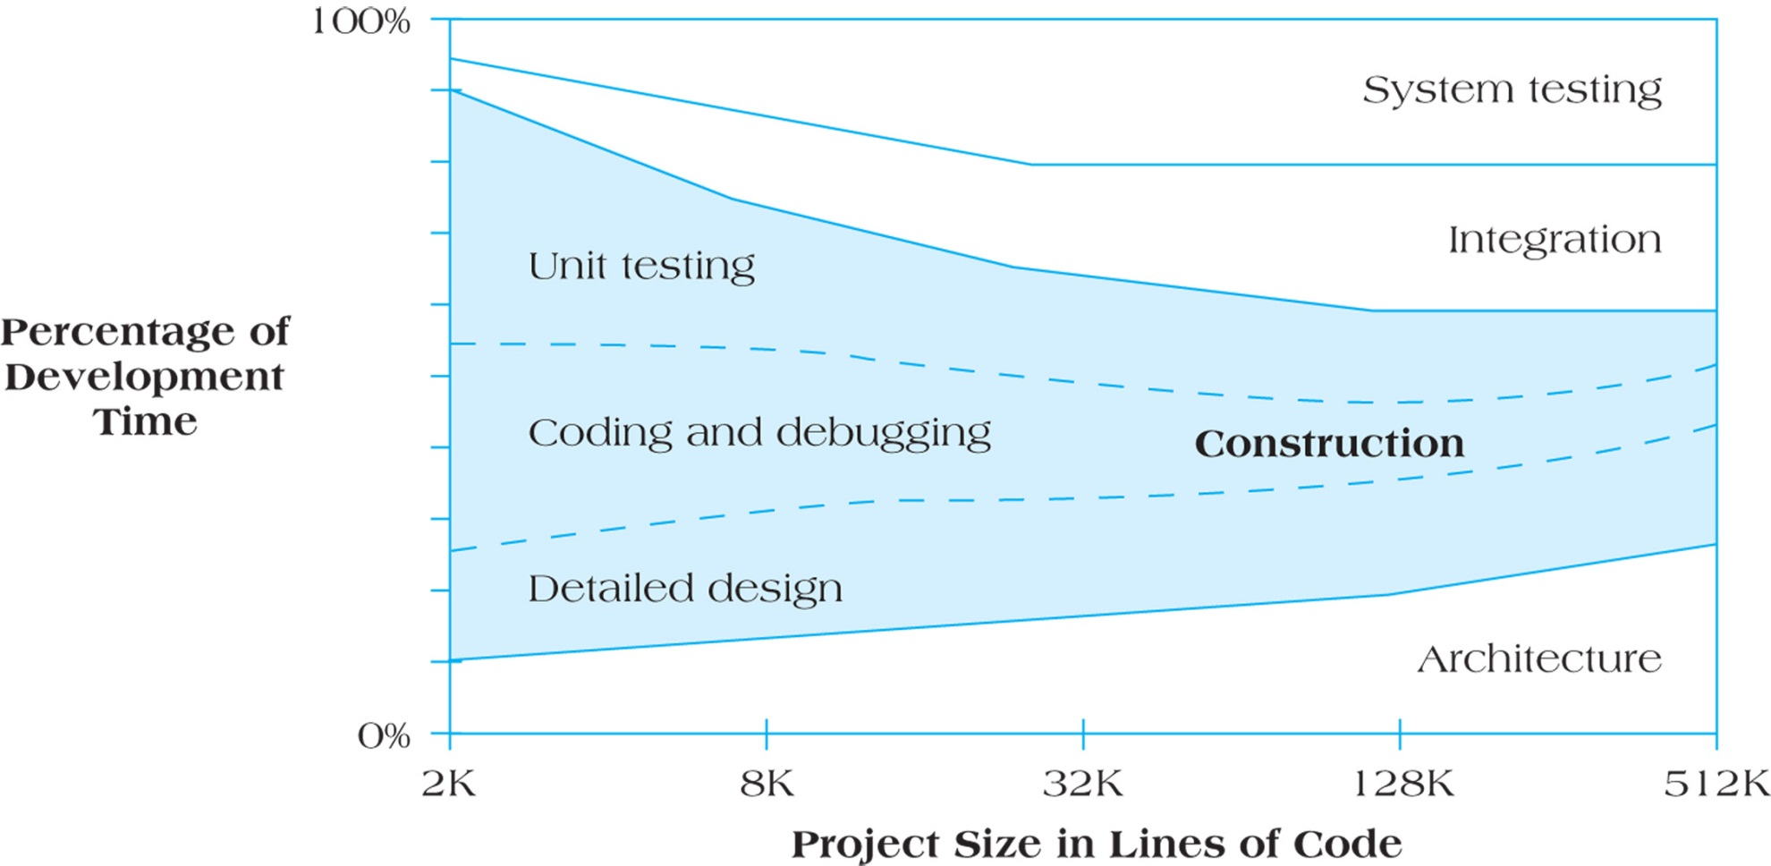
Software Project Development Activities as a Function of Size
FIGURE 8.5
Copyright © 2013 Pearson Education, Inc. Publishing as Prentice Hall

Slide 14
Complexity Weighting Table for Function Point Analysis
Copyright © 2013 Pearson Education, Inc. Publishing as Prentice Hall

Slide 15
Function Point Calculations for Restaurant Reorder System
Copyright © 2013 Pearson Education, Inc. Publishing as Prentice Hall

Slide 16
Problems with Cost Estimation
Low initial estimates
Unexpected technical difficulties
Lack of definition
Specification changes
External factors

Slide 17
Creating a Project Budget
WBS
Project Plan
The budget is a plan that identifies the resources, goals and schedule that allows a firm to achieve those goals
Scheduling
Budgeting
Top-down
Bottom-up
Activity-based costing (ABC)

Slide 18
Activity-Based Costing
Projects use activities & activities use resources
Assign costs to activities that use resources
Identify cost drivers associated with this activity
Compute a cost rate per cost driver unit or transaction
Multiply the cost driver rate times the volume of cost driver units used by the project

Slide 19
Sample Project Budget
Table 8.6
Copyright © 2013 Pearson Education, Inc. Publishing as Prentice Hall

Slide 20
Sample Budget Tracking Planned and Actual Activity Costs
Table 8.7
Copyright © 2013 Pearson Education, Inc. Publishing as Prentice Hall

Slide 21
Example of a Time-Phased Budget
Copyright © 2013 Pearson Education, Inc. Publishing as Prentice Hall
Table 8.8

Slide 22
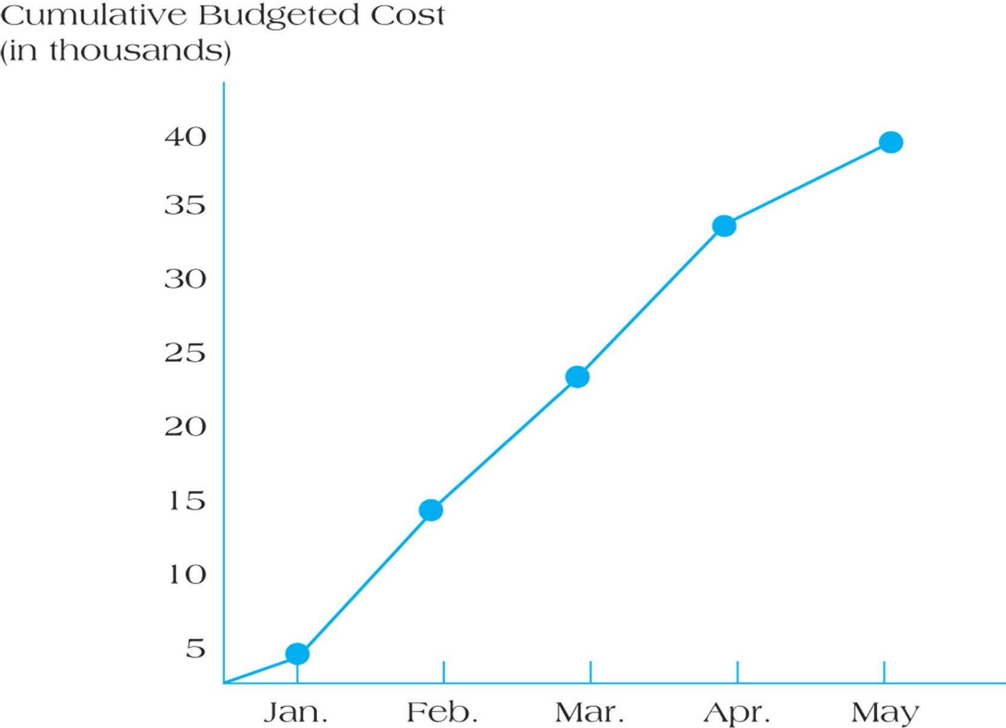
Cumulative Budgeted Cost of the Project
Figure 8.7
Copyright © 2013 Pearson Education, Inc. Publishing as Prentice Hall

Slide 23
Budget Contingencies
The allocation of extra funds to cover uncertainties and improve the chance of finishing on time.
Contingencies are needed because
Project scope may change
Murphy’s Law is present
Cost estimation must anticipate interaction costs
Normal conditions are rarely encountered

Slide 24
Summary
Understand the various types of common project costs.
Recognize the difference between various forms of project costs.
Apply common forms of cost estimation for project work, including ballpark estimates and definitive estimates.
Understand the advantages of parametric cost estimation and the application of learning curve models in cost estimation.

Slide 25
Summary
Discern the various reasons why project cost estimation is often done poorly.
Apply both top-down and bottom-up budgeting procedures for cost management.
Understand the uses of activity-based budgeting and time-phased budgets for cost estimation and control.
Recognize the appropriateness of applying contingency funds for cost estimation.

Slide 26
Copyright © 2013 Pearson Education, Inc. Publishing as Prentice Hall

